Slide 1
Remotely Operated Underwater Vehicle (ROV)
Name: Amirul Haikal Bin Shahrin
Matric Number: 1912521

Slide 2
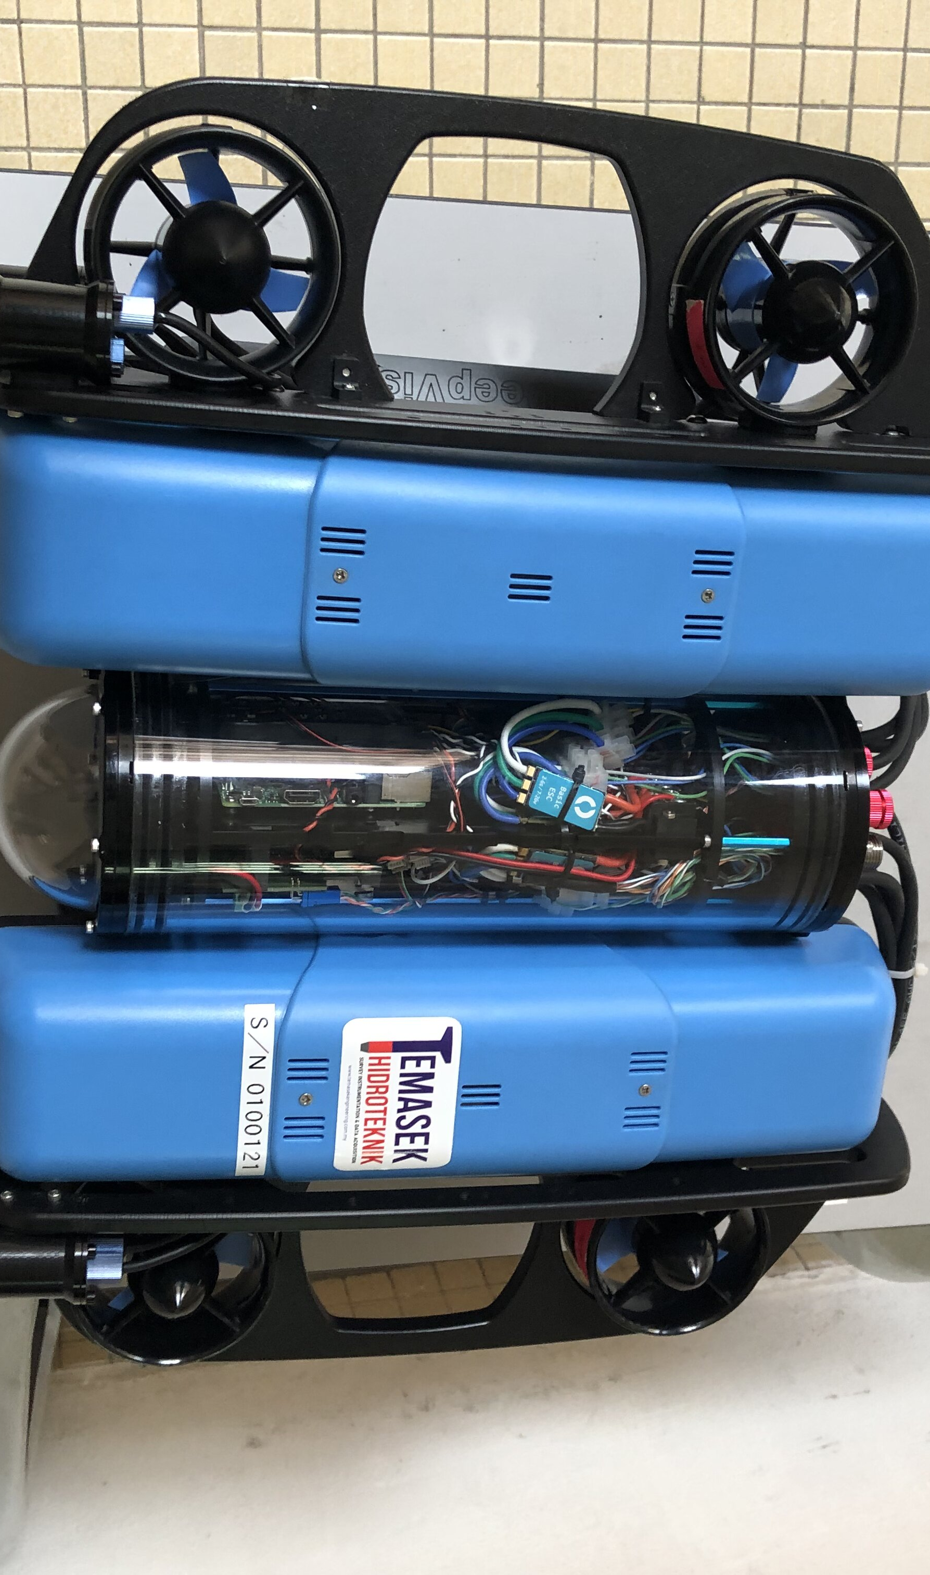
Blue ROV
Created at CUTE IIUM.
Main components:
Hull Design (Robot Design)
Navigation System & Control
Data collection (Payload)
Data transmission (Communication)
Propulsion System

Slide 3
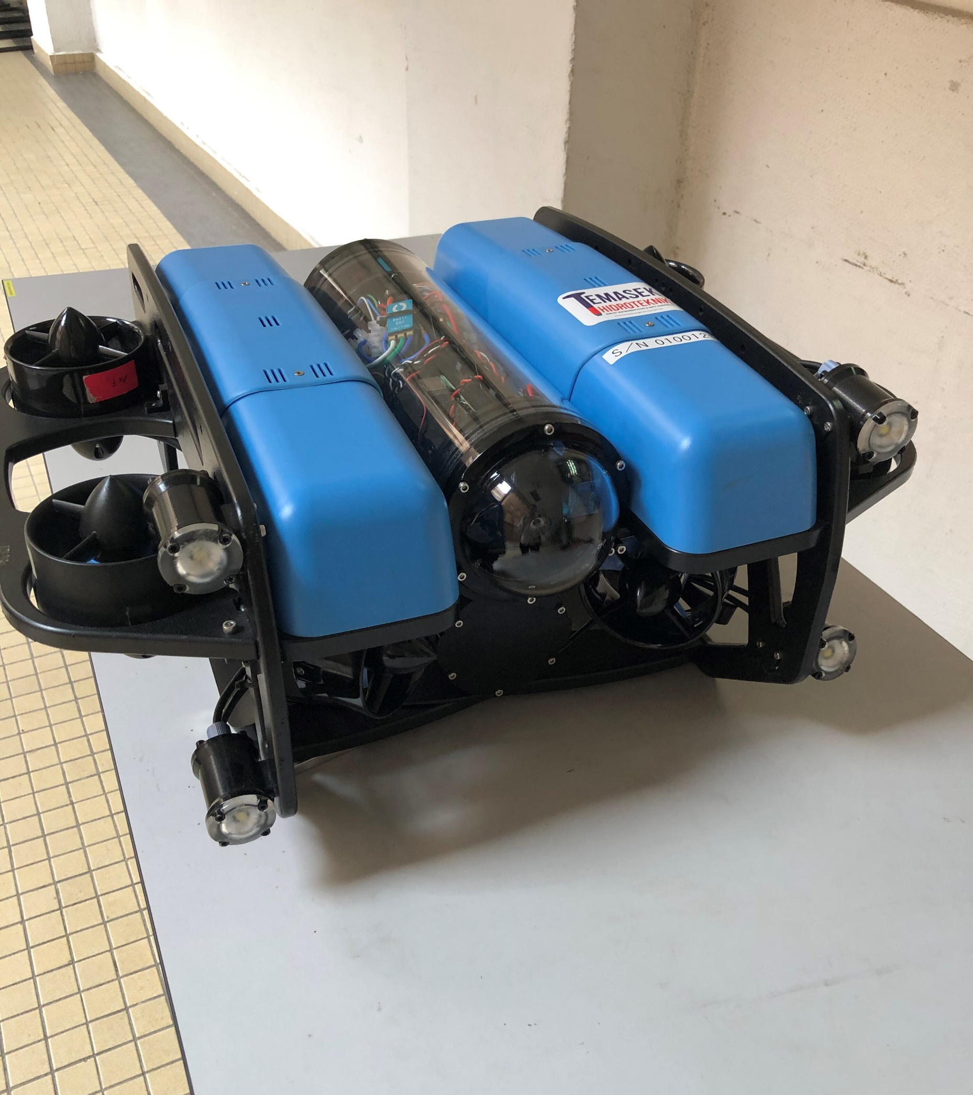
Hull Design (Robot Design)
Double rectangle shaped hull.
The body is tested by IPX 8 water test condition, where the robot is submerged into 1.5meter depth in water for 30 minutes.
IPX 8 water test condition is to protect the electrical system such as navigation system, data collection, data transmission and power management.

Slide 4
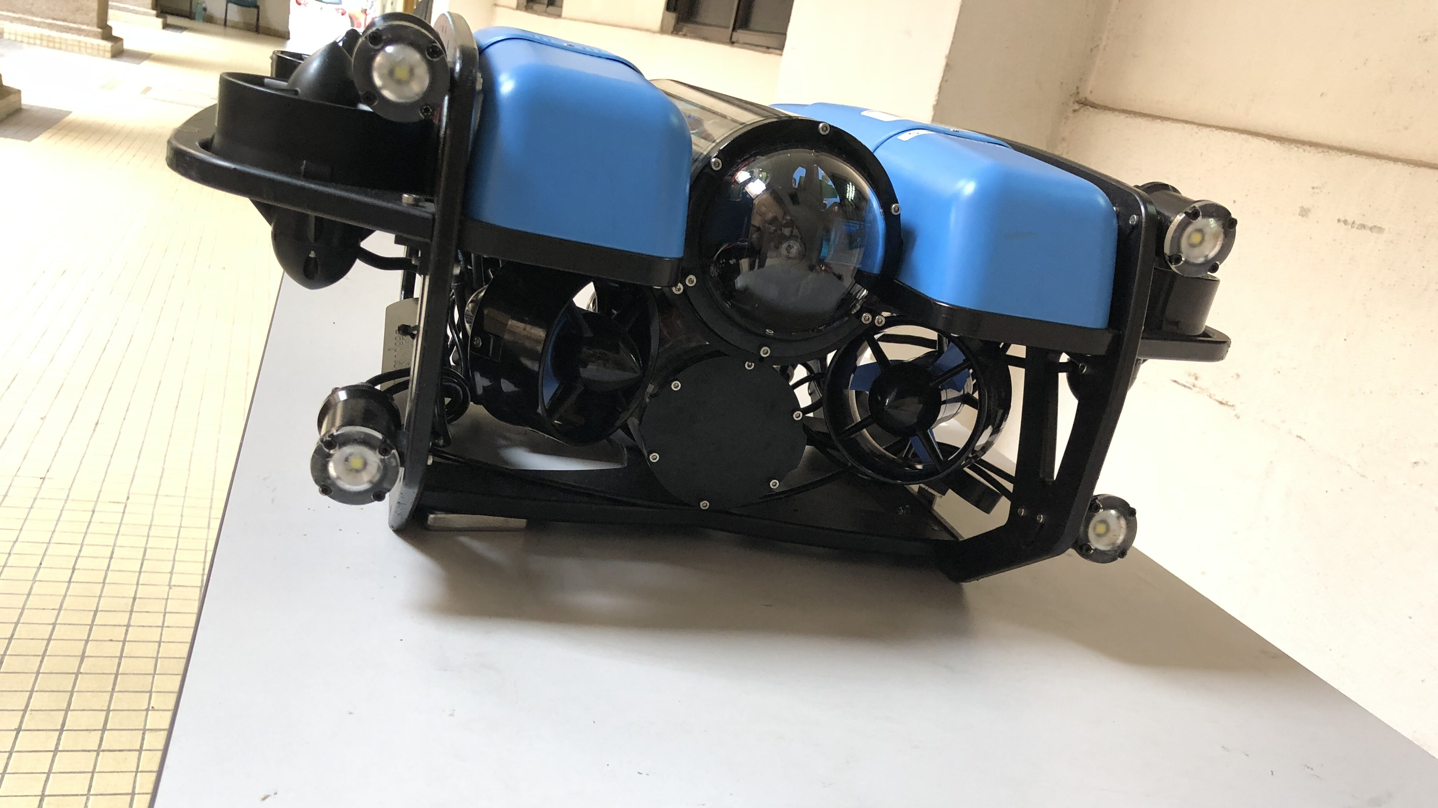
Propulsion System
8 propellers, 4 for moving vertically and another 4 for moving horizontally.
Propulsion System is controlled by the ESC in order to control the motor.

Slide 5
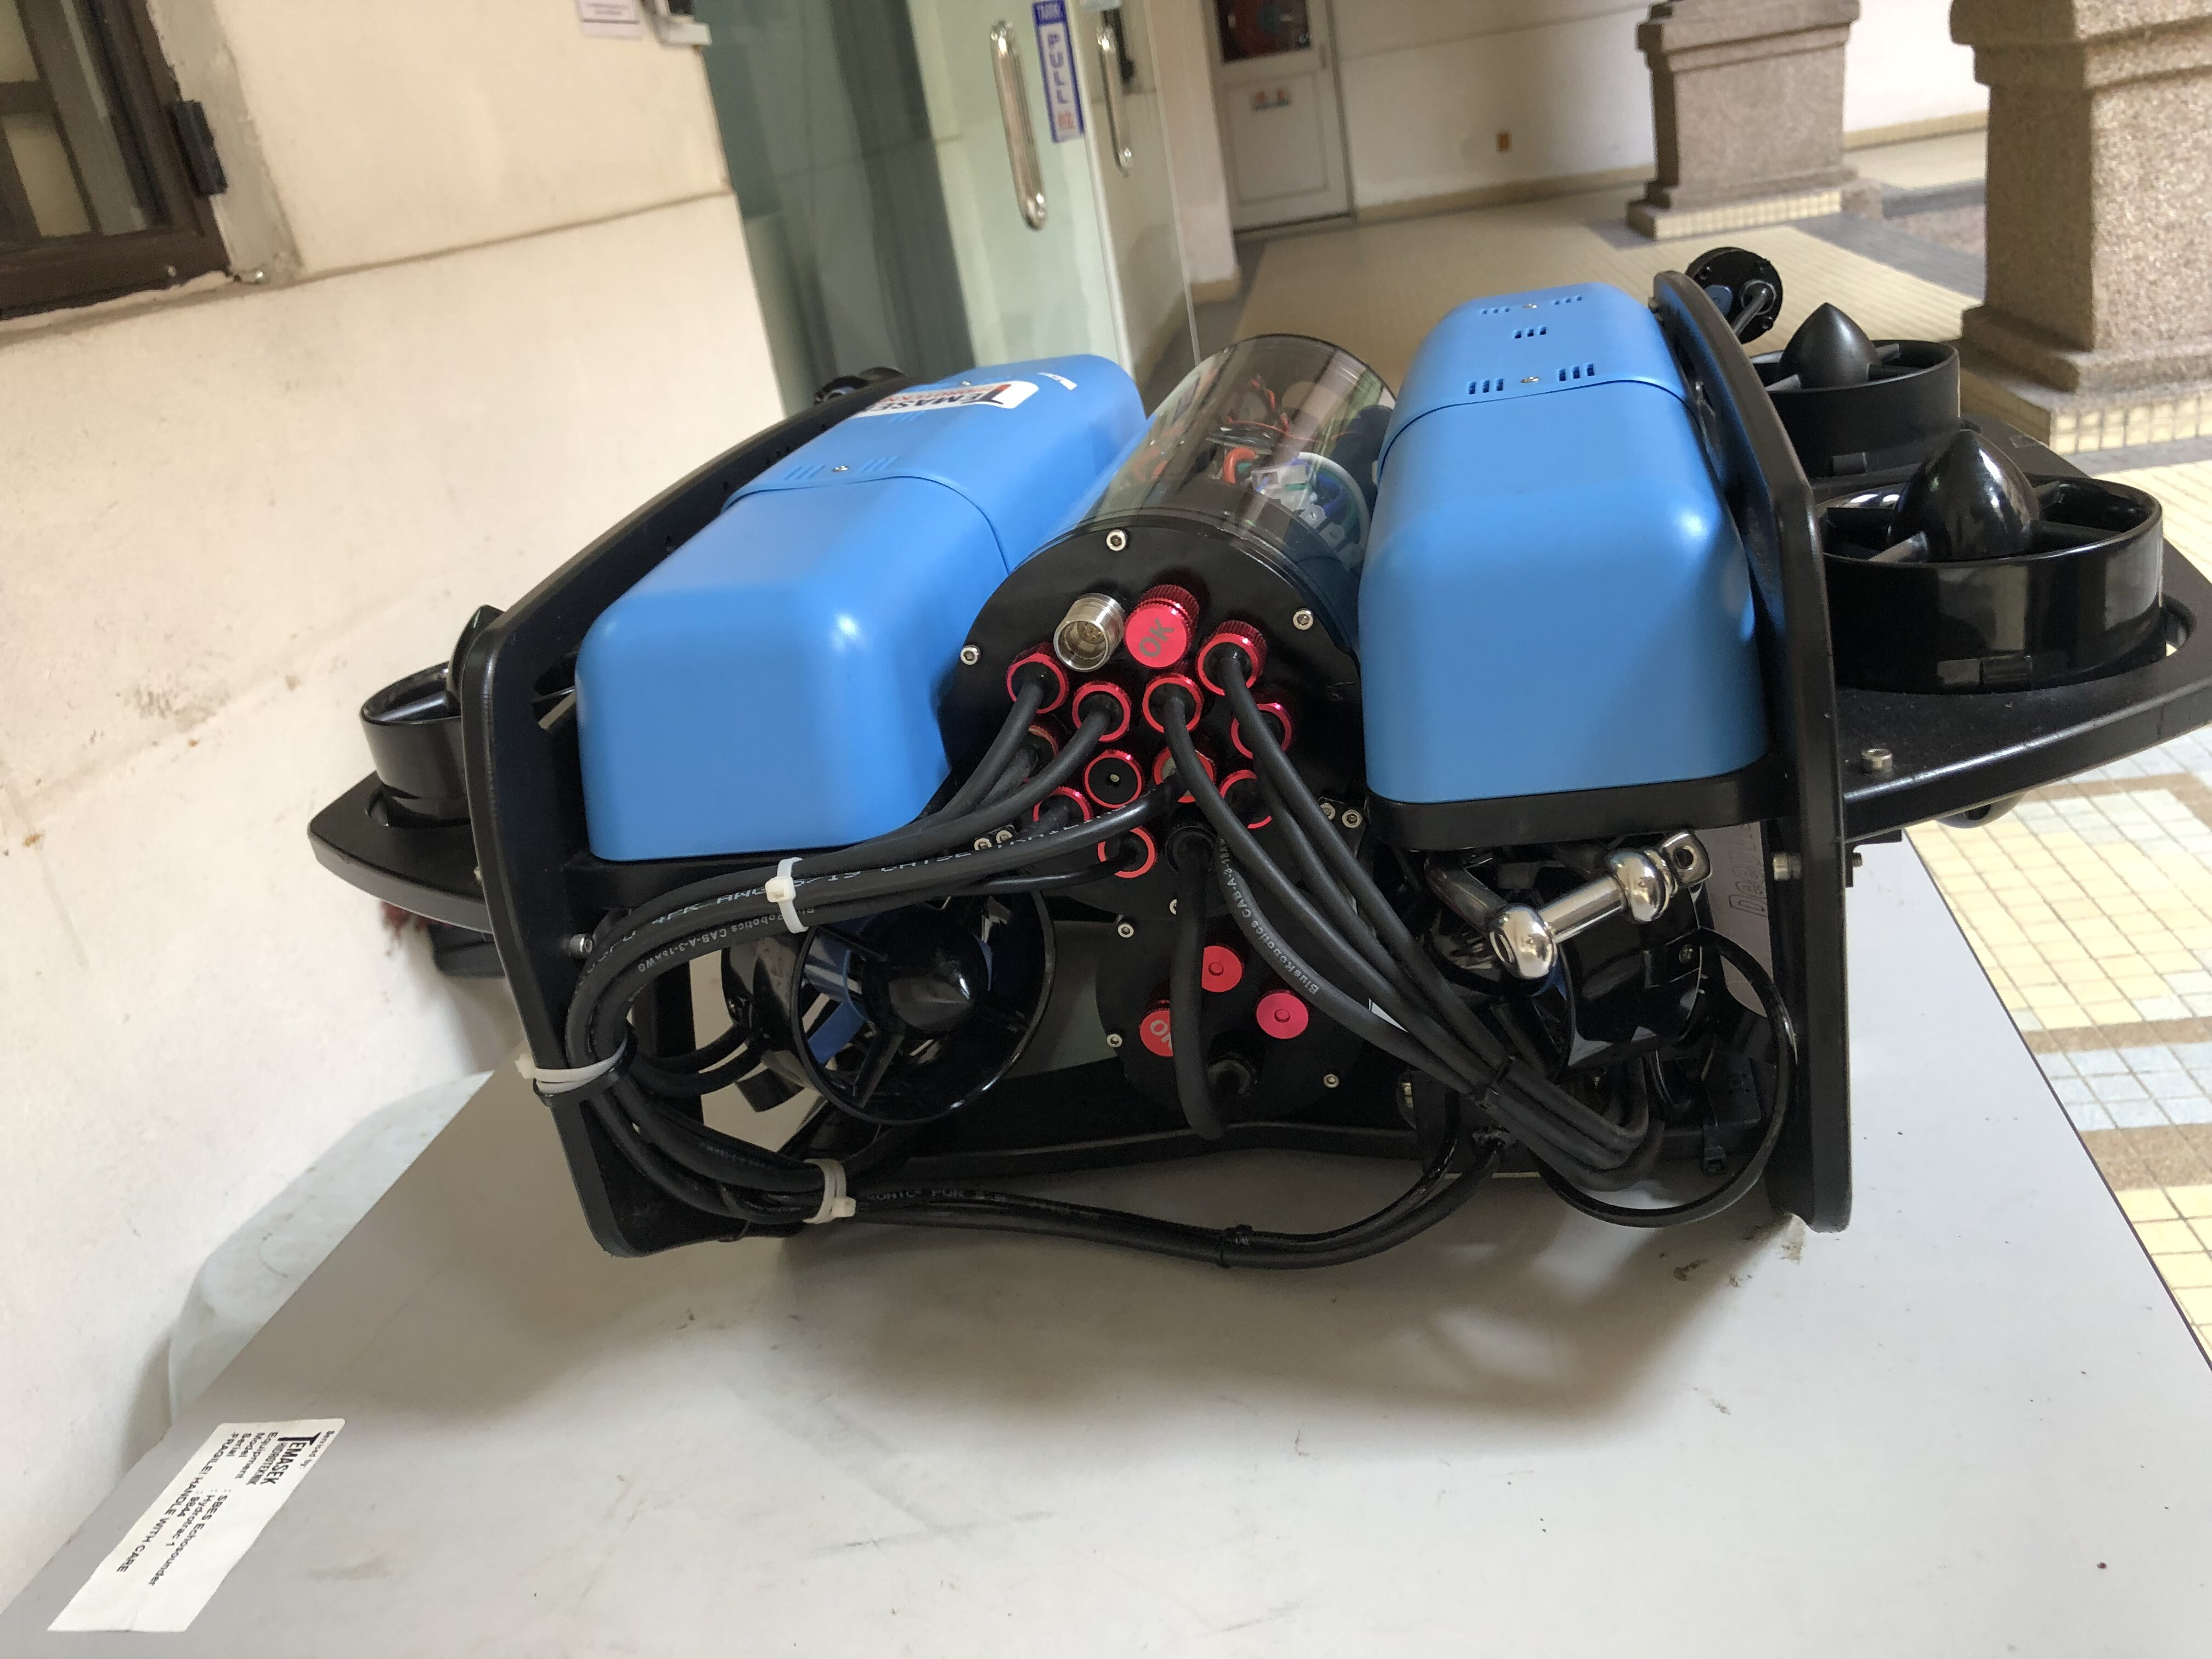
Navigation System & Control
Tether control, which involves maintaining a steady feed of tether length into the water.
Controlled using joystick.
The control system is based on an open-source autopilot called Ardupilot, which provides a customizable and flexible platform for controlling the ROV.
Uses Raspberry Pi to load the data.
Has a high-precision Attitude Heading Reference System that provides real-time orientation and position data.

Slide 6
Data Collections
High resolution camera that provides live video
Sonar Sensor
IMU Sensor
Temperature Sensor
Pressure Sensor

Slide 7
Data Transmission
- Connected through a 200meter long tether.
The wire is connected to the surface vessel.
The tether provides power and data transmission

Slide 8
Power Management
The Blue ROV is powered by a Lithium-ion battery pack that provides up to 2.5 hours of continuous operation.
The battery pack is rechargeable and can be replaced for extended operations.
The ROV also has a power management system that monitors and regulates the battery voltage, current, and temperature.
The power management system also controls the power distribution to the thrusters, sensors, and other components, ensuring optimal power consumption and efficiency.

Slide 9
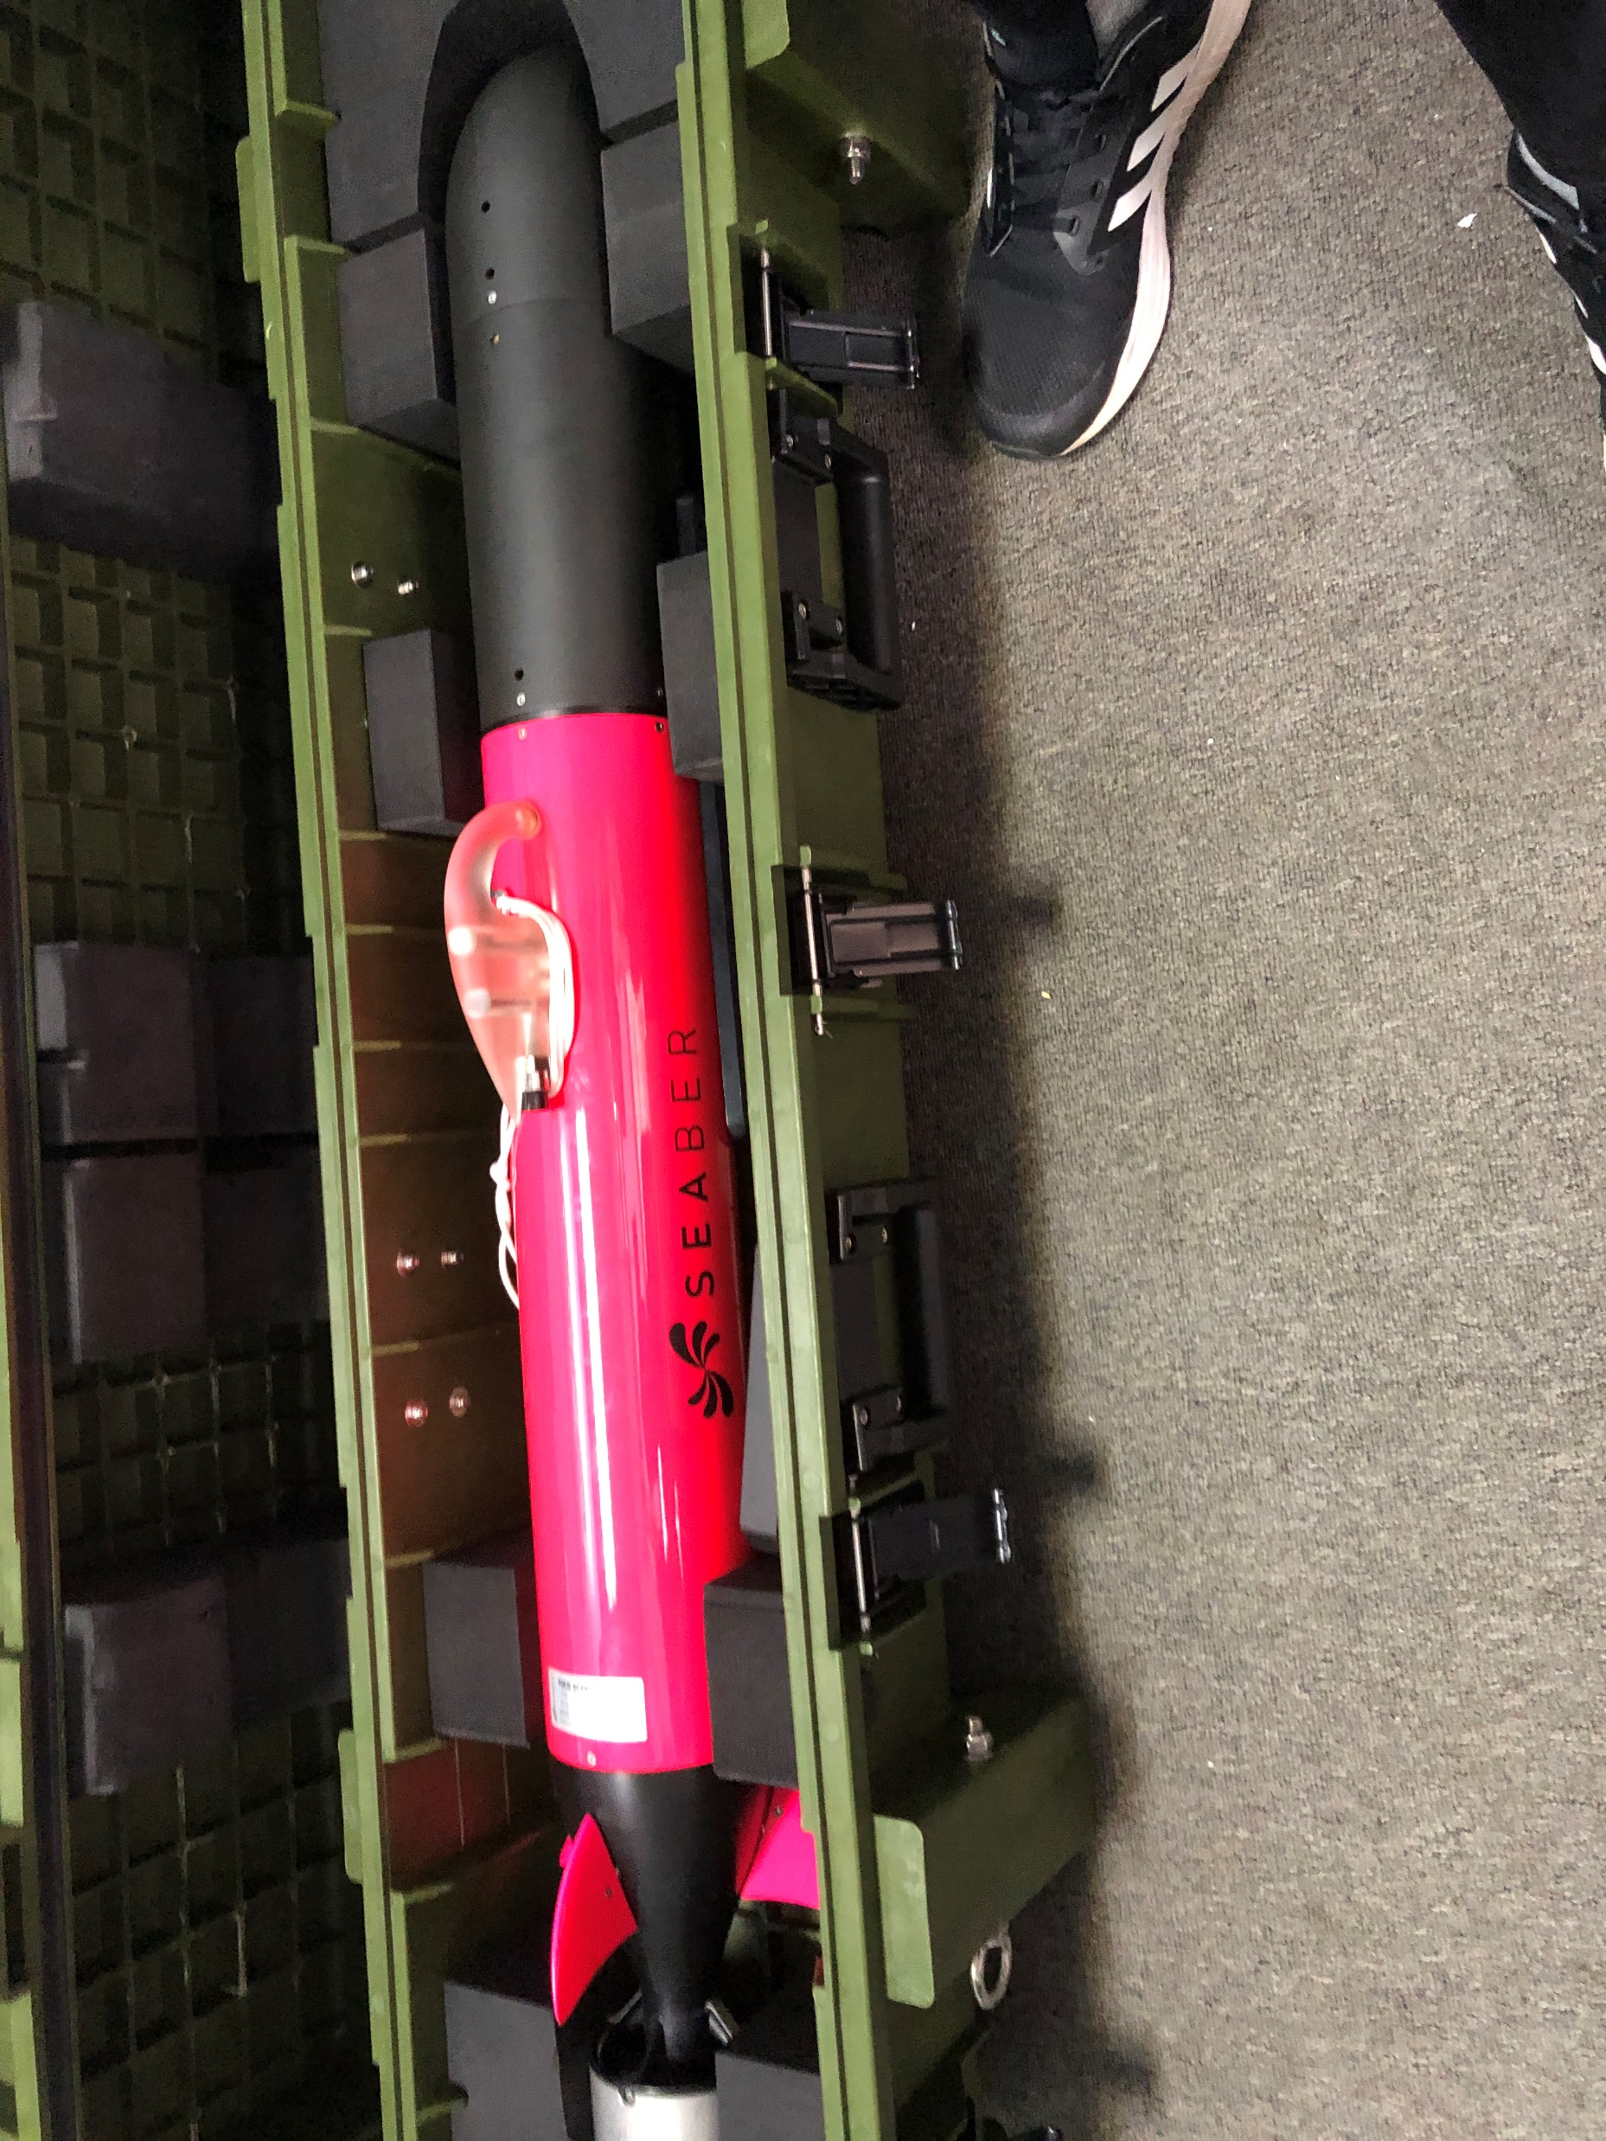

SEABER
Created at CUTE IIUM
Main components:
Hull Design (Robot Design)
Navigation System & Control
Data collection (Payload)
Data Transmission (Communication)
Propulsion System

Slide 10
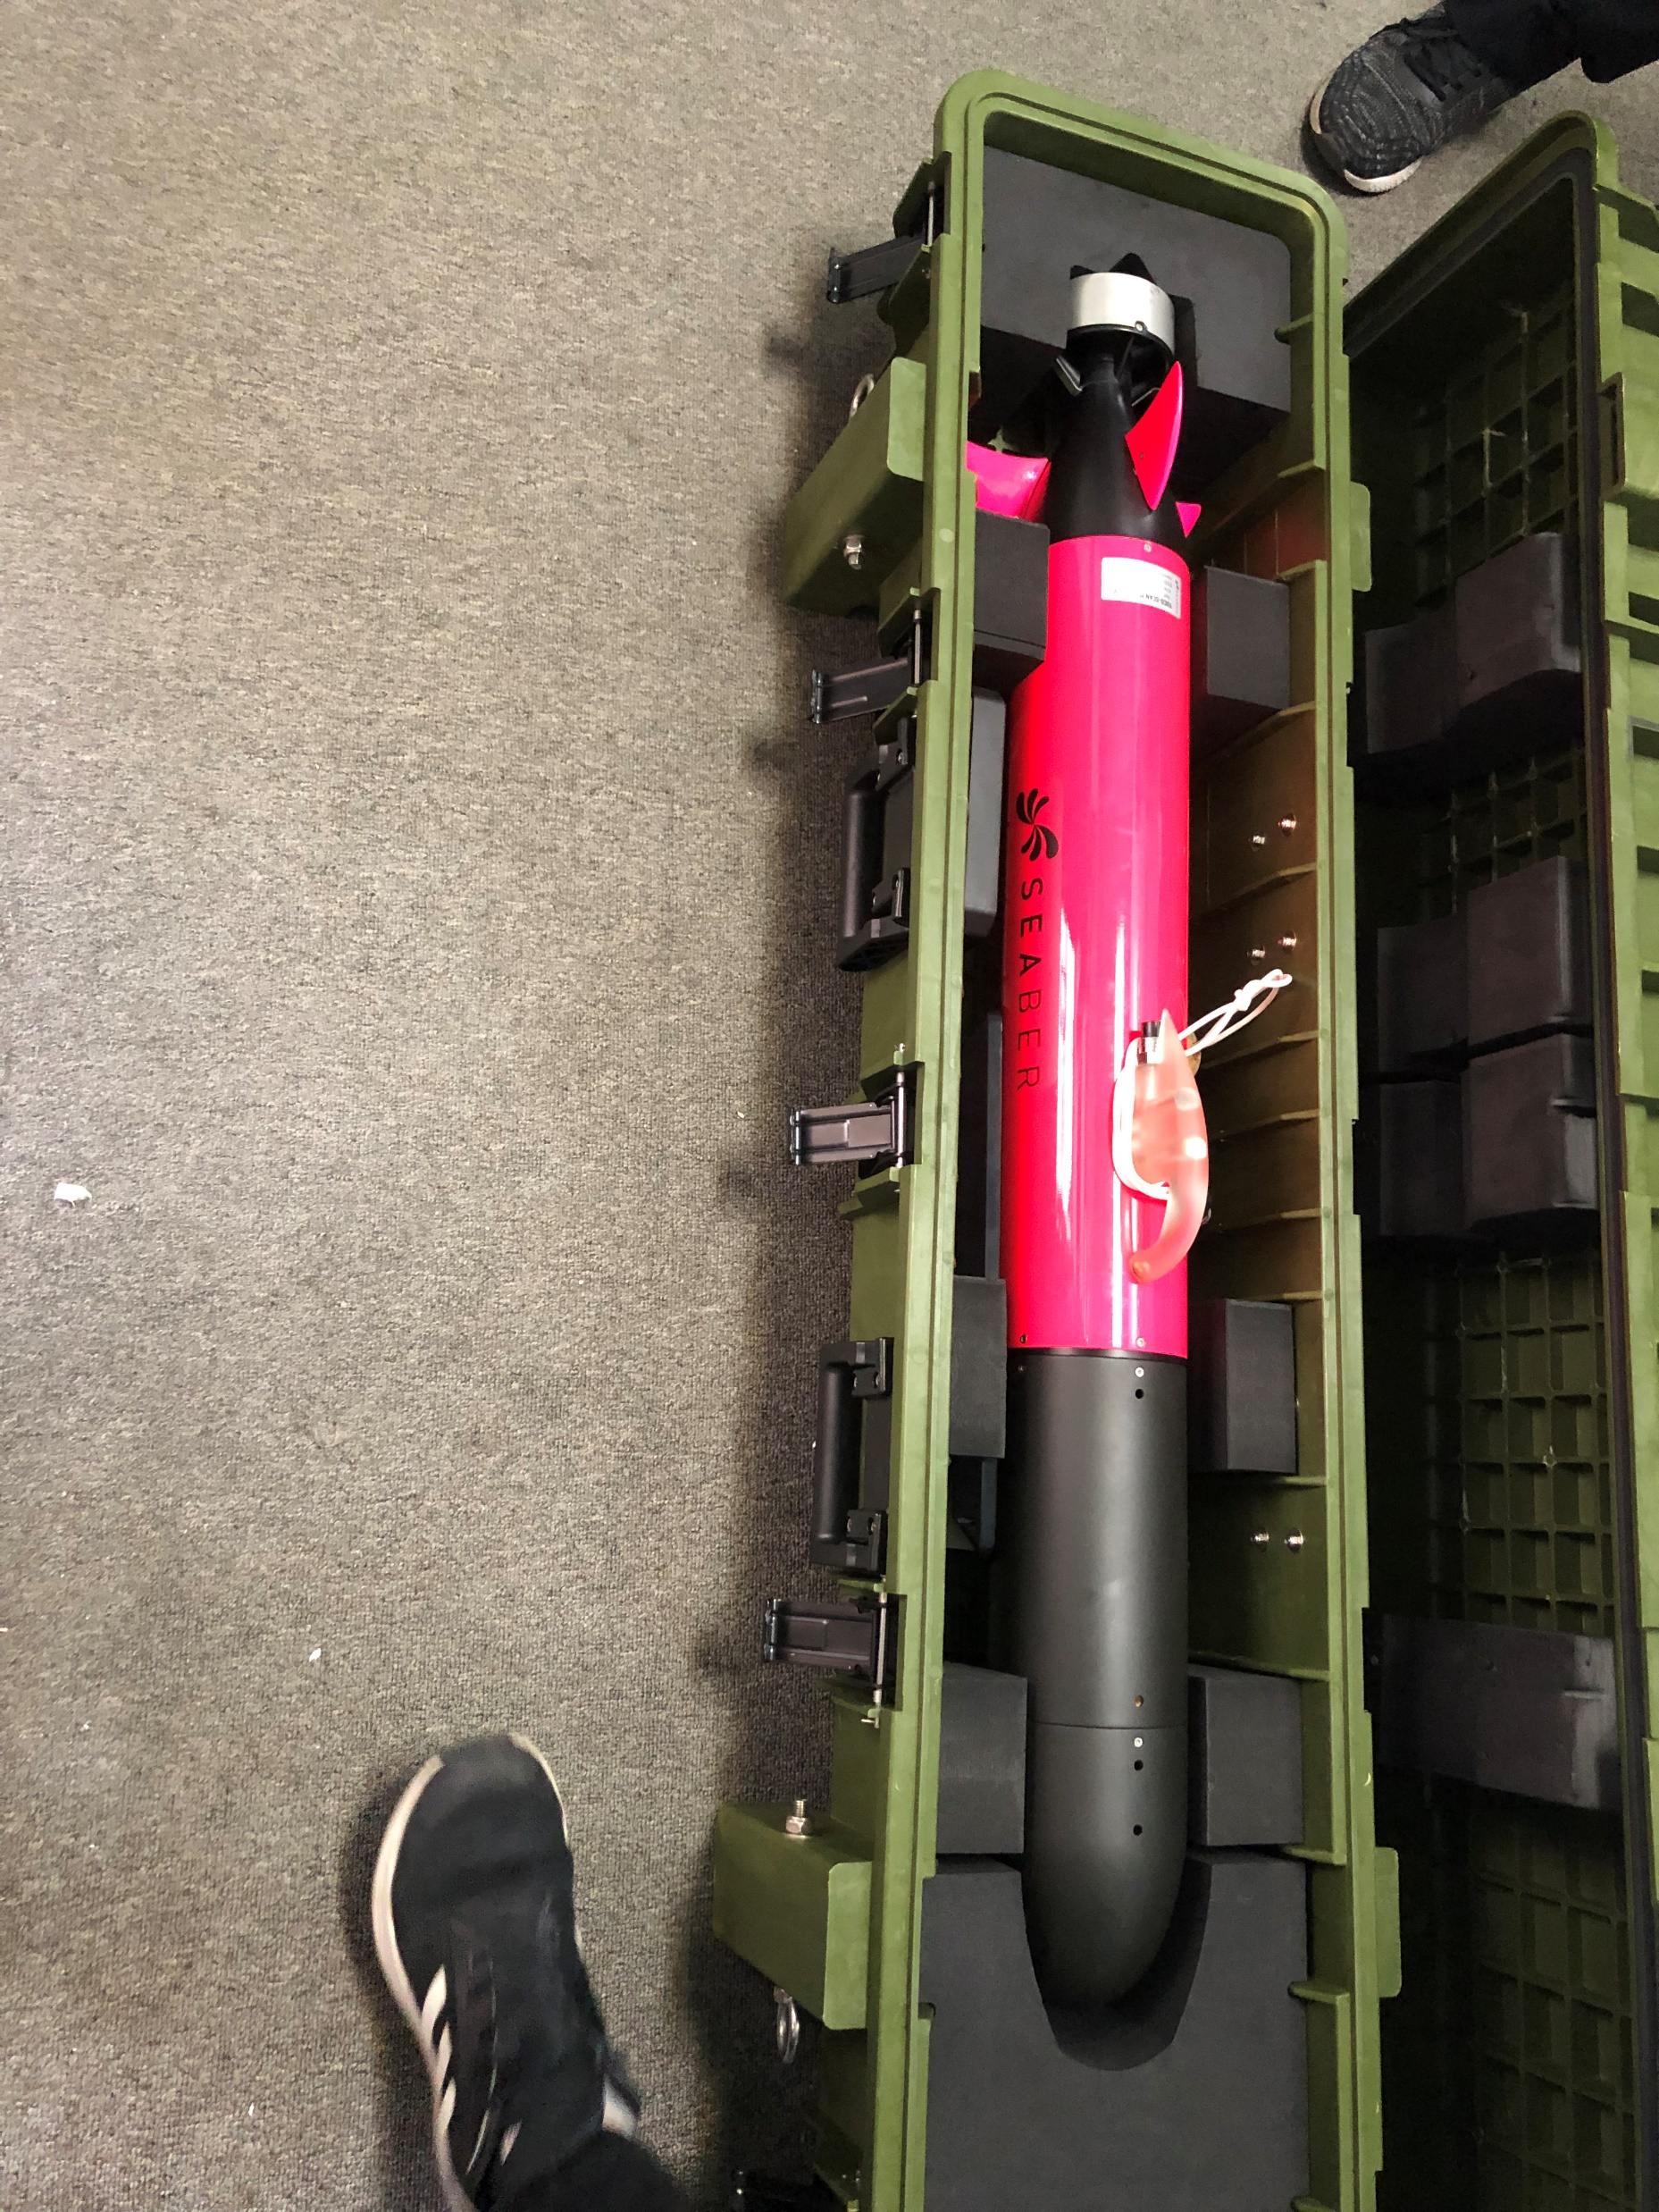
Hull Design
Submarine-shaped
Compartmented in 2 sections
The dry section is located in the middle and rear area is never to be opened by the user

Slide 11
Propulsion System
Uses 1 propeller located at the rear.

Slide 12
Navigation System & Control
Uses fin to change direction
Has camera at the front of the body
Controlled from a long distance using a remote control called SEACOMM
The remote control displays SEABER GPS position when it is at the surface and includes the auto-pilot returning function
1 LED flashlight to easily spot the robot.

Slide 13
Data Transmission
Equipped with 3 types of wireless communication antennas: satellite, GSM and radio.
Accessible via WiFi through different platforms

Slide 14
Data Collection (Payload)
The measurement devices are located at the nose of the robot which are accessible to users
This nose section also includes necessary connectors, for quick plug & play integration of new sensors such as depth sensors

